Slide 1


Slide 2


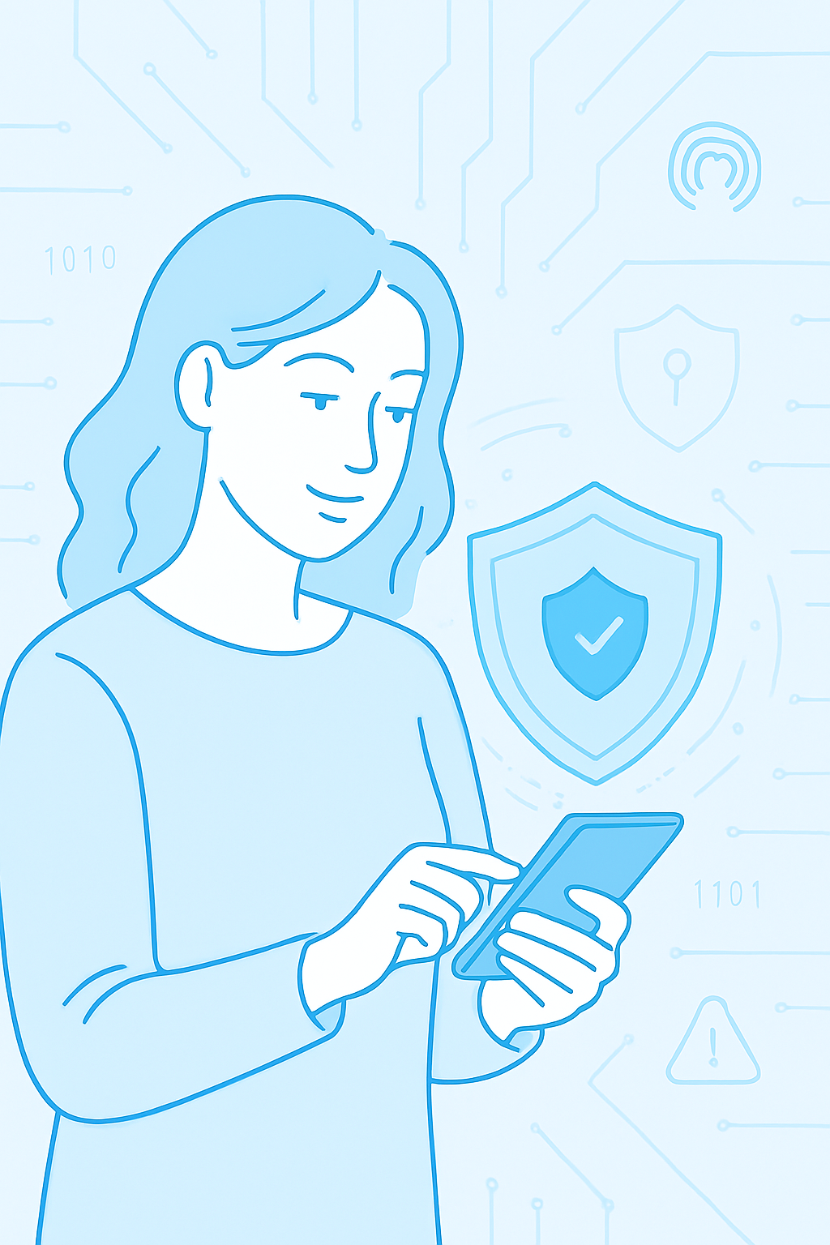

Ensuring Digital Media Safety for Women via Smart Networking, Threat Detection & Trauma Support
Team: OMEGA-X
CyberShield Hackathon 2025
Presented by: Arpan Ghoshal Devansh Dubey Ankit Tiwari

Slide 3
DIGITAL SAFETY CRISIS FOR WOMEN
Malware & Cyberattacks
Online Harassment
Surveillance & Tracking
Women are increasingly targeted by spyware, stalker ware, and phishing—especially activists, journalists, and influencers.
From doxxing to revenge porn, digital abuse disproportionately affects women, often with little recourse.
Location tracking, unauthorized access to devices, and social media monitoring compromise privacy and safety.

Slide 4
GLOBAL IMPACT AND VULNERIBILTY
Widespread Harassment
Metadata Risks
Broader Consequences
85% of women experience some form of online abuse, underscoring a pervasive safety crisis across digital platforms.
Leaked or poorly protected metadata can reveal identities, locations, and personal patterns — putting victims at further risk.
Harassment and data exposure harm mental health, restrict free expression, and discourage women’s participation in online communities.

Slide 5
OUR AGENDA
1
2
3
4
5
Ensure meta data privacy
Empower through awareness
Real-time threat alerts
Anonymous reporting channels
Scalable global deployment

Slide 6
HOW ARE PLATFORM WORKS
AI – powered threat detection
Meta data scrubbing engine
Geo- fenced emergency routing
Trauma support redirection
Scans digital environments in real time to identify Trojan malware targeting women.
Automatically removes sensitive identity and location data from shared files
Connects users to verified local emergency services using accurate location mapping
Seamlessly guides victims to mental health , legal and crisis support network

Slide 7
SMART SAFETY IN ACTION
🛡️ Malware Detection Scans digital environments for Trojan threats in real time.
🧹 Metadata Scrubbing Removes hidden identity and location data from shared files.
📍 Geo-Routed Emergency Alerts Sends location-based alerts to verified emergency services.
🔐 Anonymous Reporting Enables victims to report abuse without revealing personal details.
🧠 Trauma Support Redirection Connects users to mental health and legal support networks instantly.

Slide 8
REAL WORLD APPLICATION
THREAT ALERT TRIGGERED
META DATA PROTECTED
EMERGENCY HELP ROUTED
TRAUMA SUPPORT ACCESSED
User receives a real time notification when trojan malware is detected
Before sharing any profile and report , sensitive identity and location data is automatically scrubbed
Geo-fenced alert connects the user to verified local emergencies
User is redirected to mental health and legal support network based on locations and need.

Slide 9
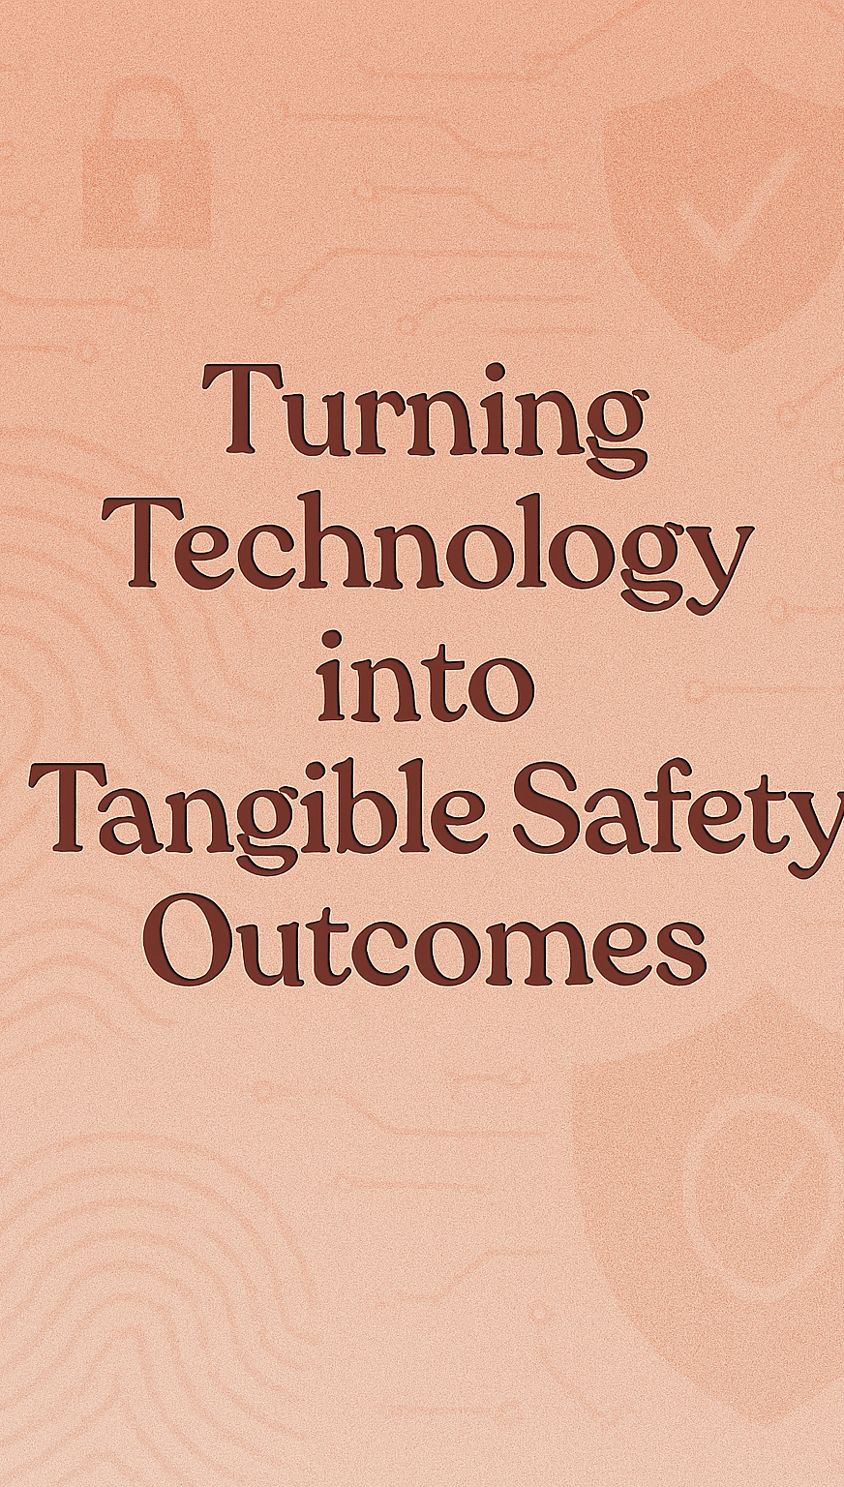
IMPACT METRIX
🚀 70% Faster Emergency Response AI and geo-routing reduce delays in critical situations.
🔐 90% Metadata Protection Accuracy Sensitive identity and location data scrubbed before sharing.
🧠 24/7 Trauma Support Access Instant redirection to verified mental health and legal aid.
🌍 Scalable Global Deployment Infrastructure designed to expand across three continents.

Slide 10
ROADMAP AND SCALABILTY
PHASE 1 – PILOT LAUNCH IN INDIA
PHASE 2 – EXPANSION ACROSS SOUTHEAST ASIA
PHASE 3 - GLOBAL TRAUMA ALLIANCE INTEGRATION
Deploy platform in high-risk zones, integrating emergency routing and trauma support with local partners for real-world validation and feedback.
Adapt platform to regional languages, legal systems, and cultural norms to ensure accessibility and relevance across diverse user communities.
Collaborate with international health networks to create a cross-border safety net for trauma support and emergency response.

Slide 11
FUTURE AND ACCESSEBILTY
PREDICTIVE SAFETY AND AI INSIGHTS
MULTILINGUAL AND INCLUSIVE DESIGN
Leverage anonymized data to forecast threats and personalize safety recommendations before harm occurs.
Ensure accessibility across languages, literacy levels, and devices so no user is left behind.

Slide 12

THANK YOU
Thank you for your attention
Our initiative is more than a tech solution –it’s a commitment to reclaiming digital safety for women
We believe safety should be a right, not a privilege. Together, let’s turn awareness into action.

